Slide 1
Webinar on MDR changes from May 2021
Welcome
Agenda:
CoS state of play – David Simmons (Director, Continuity of Supply)
MDR changes – Rob Higgins (Senior Regulatory Affairs Manager, MHRA)
Q&A
Points of contact:
Medicines contingency team: medicinescontingencyplanning@dhsc.gov.uk
MDCC contingency team: mdcc-contingencyplanning@dhsc.gov.uk
Clinical trials: ctcontingencyplanning@dhsc.gov.uk
Vaccines and Countermeasures: immunisation-mb@dhsc.gov.uk
Blood and transplants: transplants@dhsc.gov.uk
Non-clinical goods and services: nhsi.eucpc@nhs.net

Slide 2
The UK Regulatory System for Medical Devices
Rob Higgins – Devices Regulatory Group

Slide 3
Contents
Legislation
CE mark and UKCA mark
Registration requirements
UK Responsible Persons
Northern Ireland
MDR
IVDR

Slide 4
Device regulation in Great Britain

Slide 5
Legislation in Great Britain
MDD
AIMDD
IVDD
UK Medical Devices Regulations 2002
MDR
Applies in the EU on 26 May 2021 – outside of transition period
Not automatically retained by the EU Withdrawal Agreement Act
IVDR
Applies in the EU on 26 May 2022 – outside of transition period
Not automatically retained by the EU Withdrawal Agreement Act

Slide 6
Future regulatory framework
In the longer term:
We will develop a new domestic regulatory framework for devices.
Will consider international standards, best practice and global harmonisation.
Will undertake informal and formal stakeholder consultation.

Slide 7
CE marking
Valid in GB until 30 June 2023
Class I and General IVD manufacturers can continue to self-declare
Existing certificates by UK Notified Bodies are valid in GB

Slide 8
UKCA marking
Valid from now and mandatory from 1 July 2023
Requirements – MDD, AIMDD, IVDD
UK Approved Body must be used

Slide 9
UK Approved Bodies
UK Notified Bodies are now ‘UK Approved Bodies’
Will not be able to conduct conformity assessments for EU market
Will be able to conduct conformity assessments for UKCA mark

Slide 10
Designated standards
All harmonised standards that give a presumption of conformity to EU law have become ‘designated standards’.
References are published on GOV.UK.
Businesses can use designated standards to provide presumption of conformity with GB law.
Further guidance:
https://www.gov.uk/guidance/designated-standards
List of medical device standards:
https://www.gov.uk/government/publications/designated-standards-medical-devices

Slide 11
Registration of devices in Great Britain
Registration from | Medical devices to be registered* | IVDs to be registered
1 May 2021 | Class III medical devices Class IIb implantable medical devices Active implantable medical devices | IVD List A products
1 September 2021 | Class IIb non-implantable medical devices Class IIa medical devices | IVD List B products Self-test IVDs
1 January 2022** | Class I medical devices | General IVDs
*Custom-made devices to be registered in line with the risk class of the device
**Applies only to devices that are not already required to be registered

Slide 12
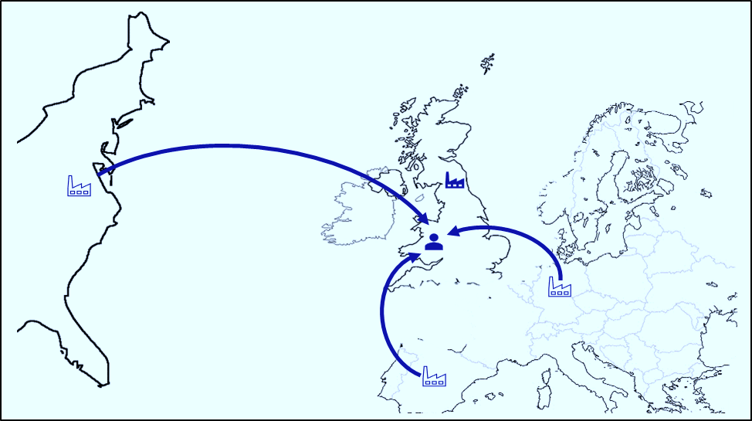
UK Responsible Person
Required for non-UK manufacturers placing devices on the GB market
Must be established in the UK
UK RPs should be in place before your device is placed on the market
UK RPs must register devices on behalf of the non-UK manufacturers in line with registration grace periods
Responsibilities set out in Regulation 7A of the 2019 EU Exit Regulations as amended by the 2020 EU Exit Regulations

Slide 13
Timeline overview and key actions: GB
1 Jan 2021
1 May 2021
1 Sept 2021
1 Jan 2022
1 July 2023
UK RP should be in place
UKCA mark introduced
Register Class III, IIb implantable devices, IVD List A products
Register Class IIb non-implantable and IIa devices, IVD List B products and self-test IVDs
Register Class I devices and general IVDs (for devices not already required to be registered)
End of recognition of CE mark
UKCA mark must be used

Slide 14
Device regulation in Northern Ireland

Slide 15
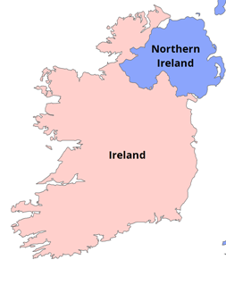
Northern Ireland Protocol
October 2019 – the NI Protocol was agreed
Northern Ireland will have access to the EU Single Market
UK Government has made commitments on unfettered access

Slide 16
MDR and IVDR in Northern Ireland
MDR
Applies in the EU on 26 May 2021 – outside of transition period
Will fully apply in Northern Ireland under the NI Protocol
IVDR
Applies in the EU on 26 May 2022 – outside of transition period
Will fully apply in Northern Ireland under the NI Protocol

Slide 17
CE marking and CE UKNI marking
CE marking will continue to be used
Manufacturers can continue to self-certify devices to EU standards where relevant
Where third party assessment is required:
If an EU Notified Body is used, a CE marking must be applied – will be valid for NI and the EU
If a UK Notified Body is used, a UKNI marking must accompany, but not replace, the CE marking – valid for NI market only
The UKCA mark alone will not be valid for the NI market

Slide 18
EU Medical Devices Regulations (MDR) and In Vitro Diagnostic Regulations (IVDR)

Slide 19
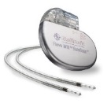
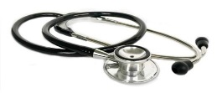
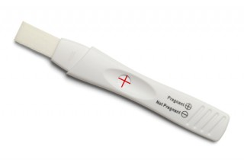
The legislation
Active Implantable Medical Devices Directive (90/385/EEC)
Medical Devices Directive (93/42/EEC)
In vitro Diagnostic Medical Devices Directive (98/79/EC)
EU Regulation 2017/745 on medical devices
(MDR)
EU Regulation 2017/746 on in vitro diagnostic devices
(IVDR)

Slide 20
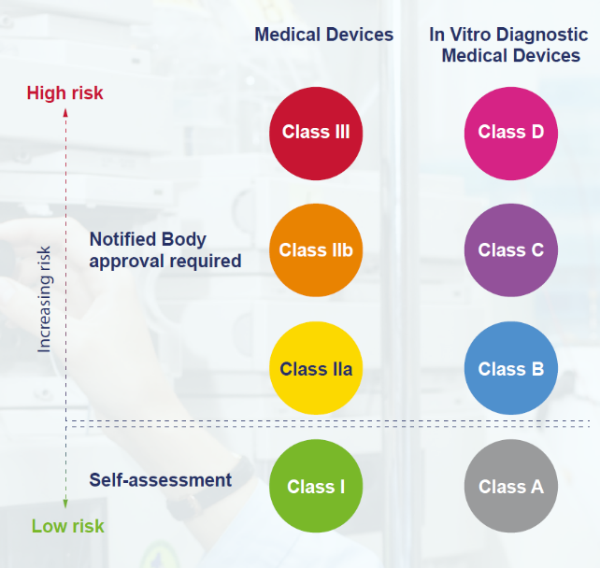
Classification
Notes:
20

Slide 21
Key Changes in the MDR/IVDR
Strengthening of the PMS system
Requirement for a person responsible for regulatory compliance
Requirement for a Unique Device Identification (UDI)
New requirements for importers and distributors

Slide 22
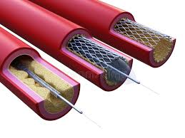
Key Changes in the MDR
Devices incorporating non-viable human tissues or cells are now included
Products with characteristics similar to medical devices but which have an aesthetic purpose (eg plano contact lenses, dermal fillers) are now included
Most companies will need to update clinical data, technical documentation, and labelling
Reclassification of many medical devices (eg substances and software) to a higher risk class and a new classification for reusable surgical devices requiring notified body oversight

Slide 23
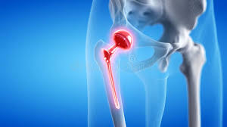
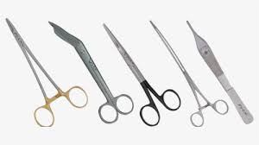
Key Changes in the MDR (Cont)
Requirement for a Summary of Safety and Clinical Performance for implantable devices and for Class III devices
Most companies will need to update clinical data, technical documentation, and labelling
Reclassification of many medical devices to a higher risk class (eg substances, software) and a new classification for reusable surgical devices requiring notified body oversight

Slide 24
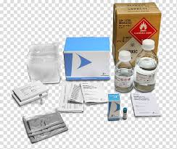
Key Changes in the IVDR
Expanded definition of IVDs (eg software and companion diagnostics)
A new classification of IVDs requiring much closer scrutiny by Notified Bodies
More detailed information is required concerning the analytical and clinical performance of the device
The manufacturer must sufficiently demonstrate that their device can achieve the intended clinical benefit and safety
Summary of safety and performance for class C and D devices,

Slide 25
Device regulation: https://www.gov.uk/guidance/regulating-medical-devices-in-the-uk
Device registration: https://www.gov.uk/guidance/register-medical-devices-to-place-on-the-market
Designated standards: https://www.gov.uk/government/publications/designated-standards-medical-devices
Contact: Devices.Regulatory@mhra.gov.uk

